Slide 1

Flight Price Analytics
Project Report

Slide 2

Project Overview
Core Question
Solution
"Buy now or wait?" for flight prices.
End-to-end analytics stack for actionable pricing signals.
Deliverable
One-page Power BI dashboard.

Slide 3

Dataset Summary
Grain: One row per (route, search_date, depart_date) fare snapshot.
Core Fields: origin, destination, route, price, search_date, depart_date, lead_time_days.
Span: ~June 2025 – November 2025 (scalable).
Derived Fields: lead-time bucket, is_weekend, 7-day baseline, 7-day % change.
Rows/Cols: 133,776 rows, 9 columns.

Slide 4

Exploratory Data Analysis (Python)
01
02
Data Health
Feature Engineering
NA scan, duplicate scan, clipped non-positive prices.
Lead_time_days, lead_bucket, is_weekend, 7-day rolling baseline.
03
Quick EDA
Seasonality, U-shaped lead-time curve, weekend effect.

Slide 5
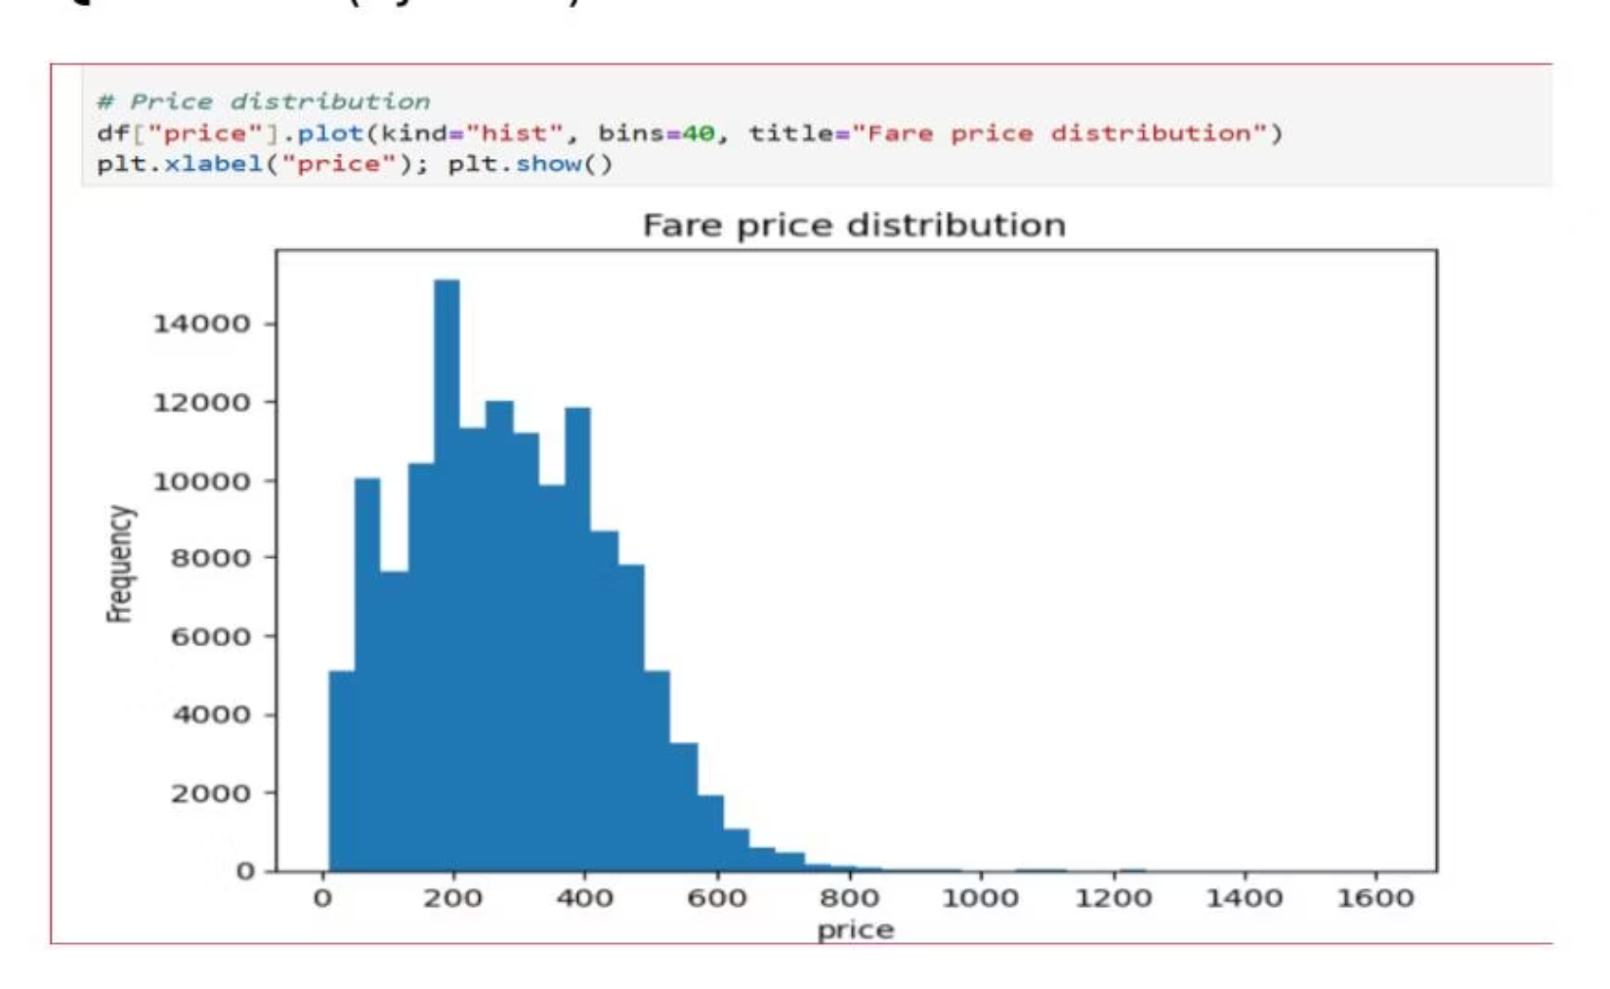
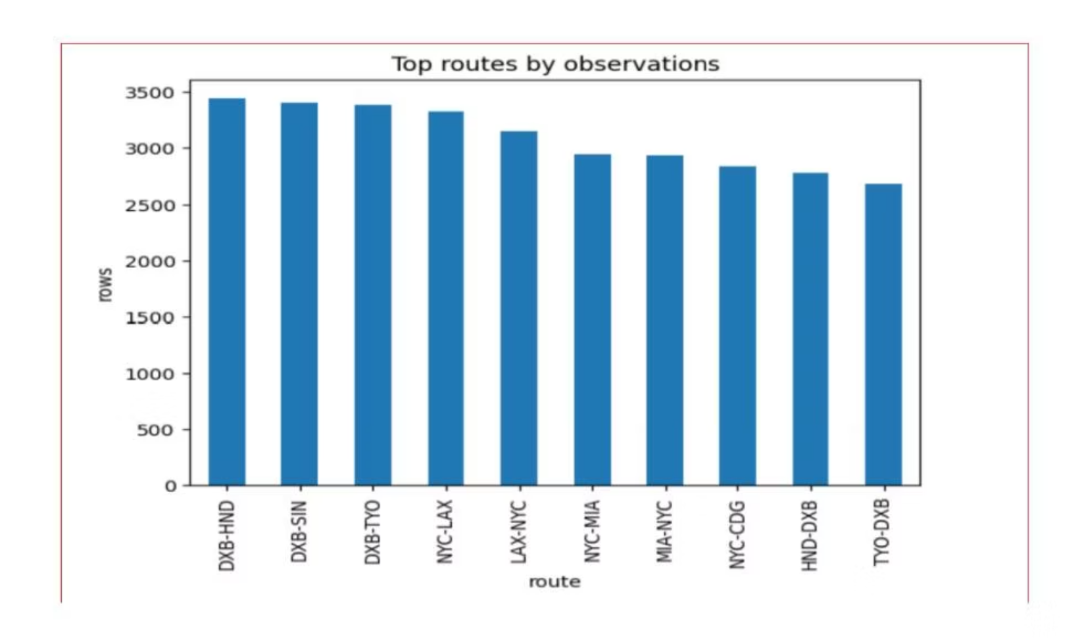
Key EDA Findings
Seasonality
Lead-time Curve
Visible month-to-month waves in average search-day price.
Some routes show U-shaped price vs. lead time.
Weekend Effect
Weekend mean < weekday mean for several routes.

Slide 6

Data Analysis using SQL
Price Volatility
Identify most volatile routes for alerts.
Lead-time Price Curve
Analyze price trends for specific routes.
"Buy or Wait" Logic
Flag if latest price is ≥10% below 30-day median.
Cheapest Departure Day
Determine optimal day of week to depart.
Best Booking Window
Find lead time with lowest average price.

Slide 7
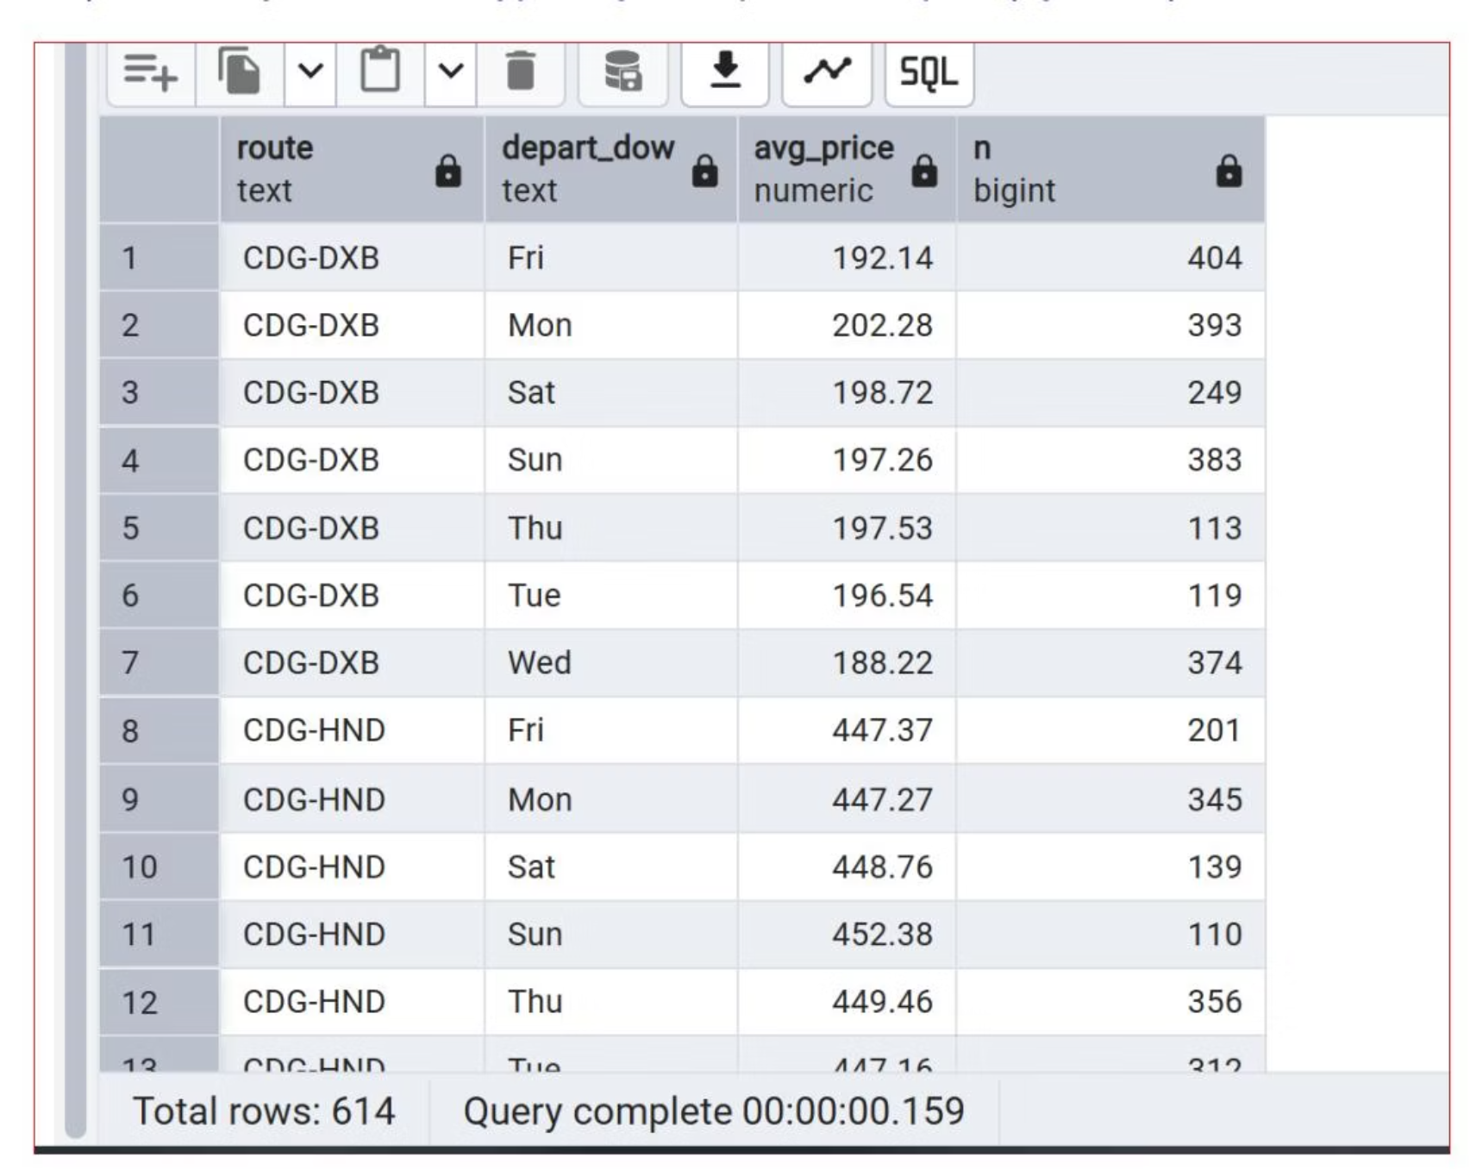
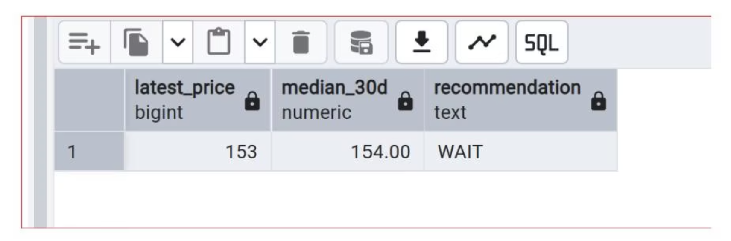
SQL Insights
Volatile Routes
Cheapest Day to Depart
HND-MIA
149
631.88
150.72
TYO-MIA
149
551.44
141.79
Best Booking Window
CDG-DXB
40
181.38
CDG-HND
22
426.25

Slide 8
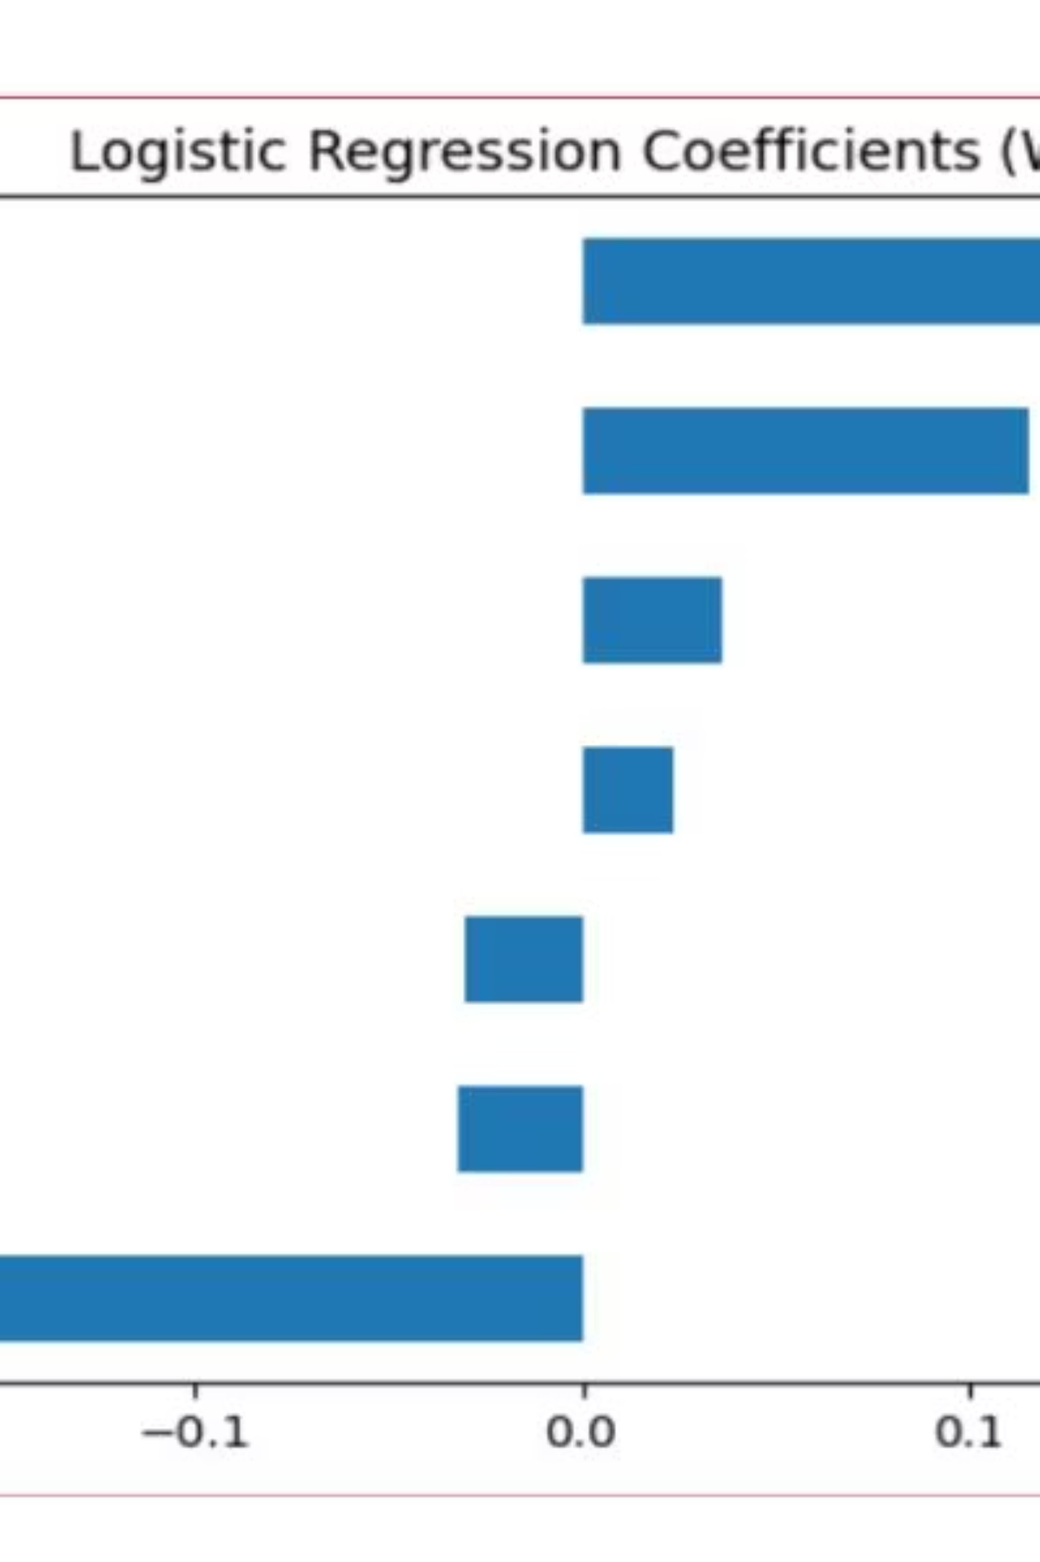

Buy/Wait ML Model
1
Supervised Classification
Framed "Buy now vs Wait" problem.
2
Engineered Features
Price vs. mean, volatility, days-to-departure, DOW/month, weekend.
3
Model Training
Logistic regression, random forest with time-based cross-validation.
4
Evaluation
ROC AUC, precision/recall, confusion matrices.

Slide 9
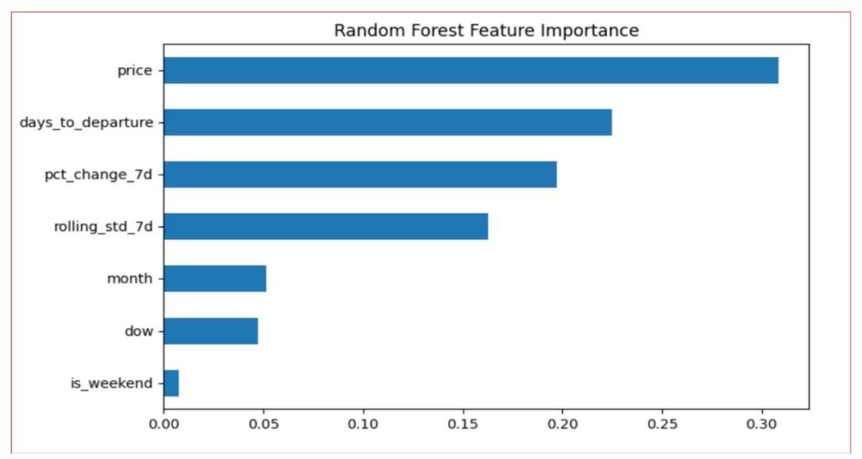
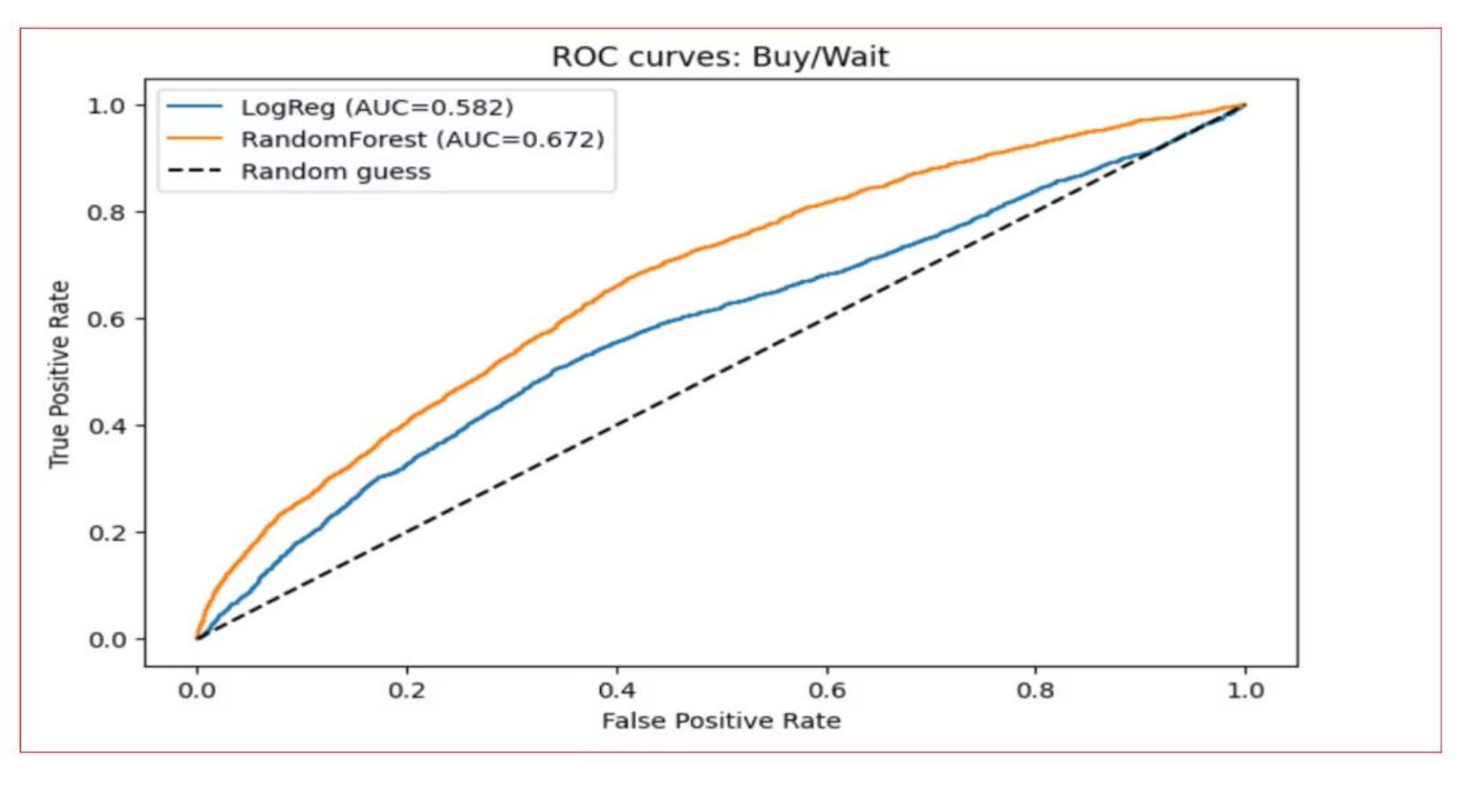
Model Performance
ROC Curve
Confusion Matrix
Exposed a simple buy_or_wait() helper for app and alerts.

Slide 10





Business Recommendations
Daily "Buy" List
When to Book
Weekend Messaging
Flag if ≥10% cheaper than 30-day median.
Publish best lead-time window per route, refresh monthly.
Promote "Save more on weekend departures" if cheaper.
Volatility Watchlist
ML Guidance
Track high variance routes, add price-drop badges.
Use random forest model for "Buy/Wait" recommendations.

